Slide 1

Cognitive Labs
Lab 5: Watson Natural Language Understanding

Slide 2
Objective
Build a Cognitive Text Analyser that:
allows a user to enter either raw text or a link to a webpage on a Node-RED dashboard
runs the text or the webpage content through Watson Natural Language Understanding (NLU)
presents a summary of the content and the NLU metadata back to the user on the same dashboard
the metadata displayed includes overall sentiment analysis, extraction of entities, and sentiment analysis of each of the entities discovered

Slide 3
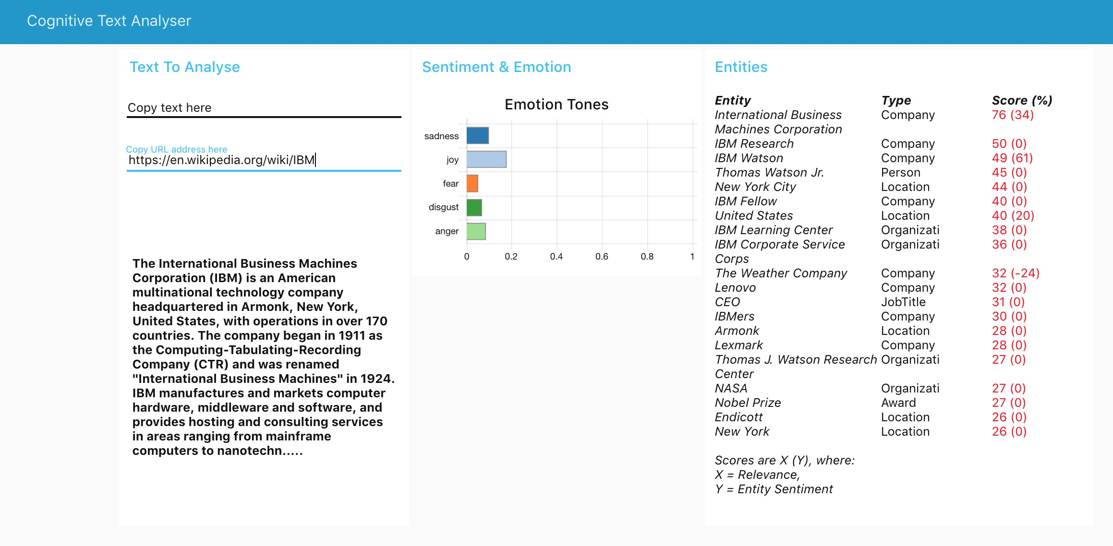
Objective

Slide 4
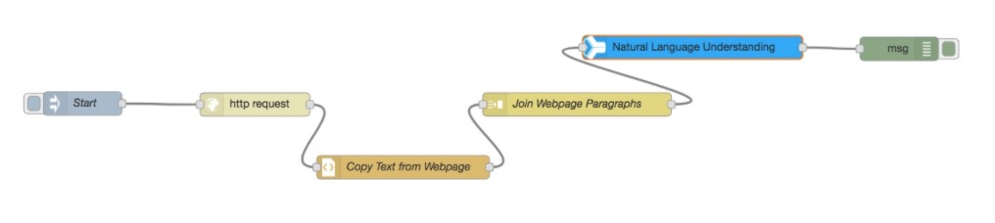
Agenda
build a Node-RED flow to analyse text from a web page
import Node-RED dashboard components
format Watson NLU output for dashboard table and chart
test your new Cognitive Text Analyser app

Slide 5
What is Watson NLU?
Watson Natural Language Understanding (NLU) allows us to
uncover insights from structured and unstructured data
analyse the semantic features of text input by extracting metadata from content
e.g. concepts, entities, keywords, categories, relations and roles
It can also understand sentiment and emotion, and returns
overall sentiment and emotion for a document
targeted sentiment and emotion against keywords in the text
Provides supports in 13 languages

Slide 6
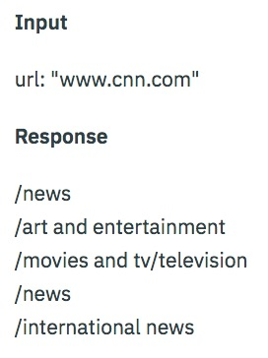
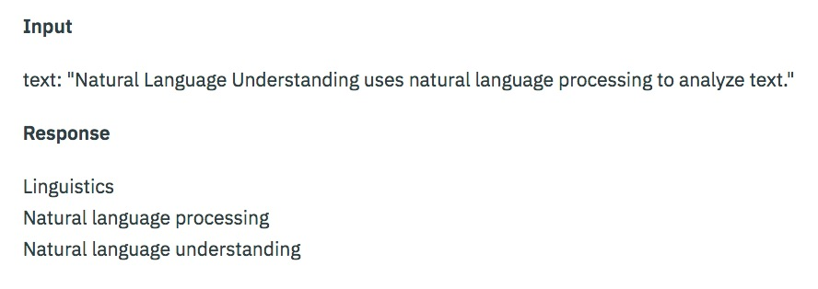
Using the NLU service
Send requests to the API with text, HTML, or a public URL, and specify one or more of the following features to analyse
Categories
Categorise your content using a five-level classification hierarchy
Concepts
Identify high-level concepts that aren't necessarily directly referenced in the text

Slide 7
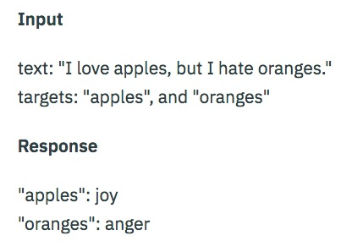
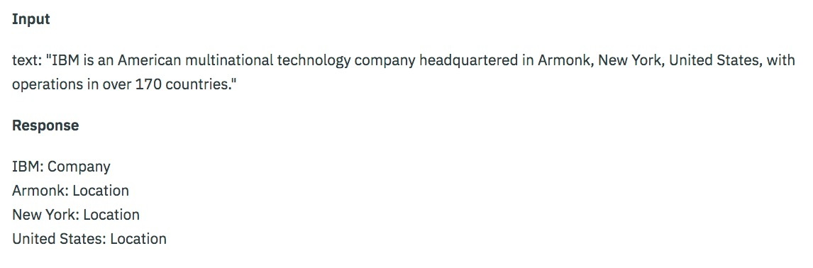
Using the NLU service
Send requests to the API with text, HTML, or a public URL, and specify one or more of the following features to analyse
Emotion
Analyse emotion conveyed by specific target phrases or by the document as a whole
Entities
Find people, places, events, and other types of entities mentioned in your content

Slide 8
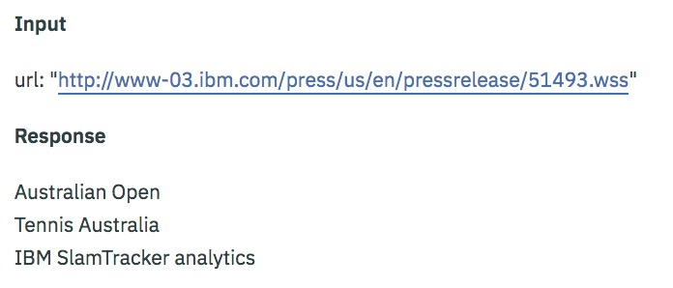
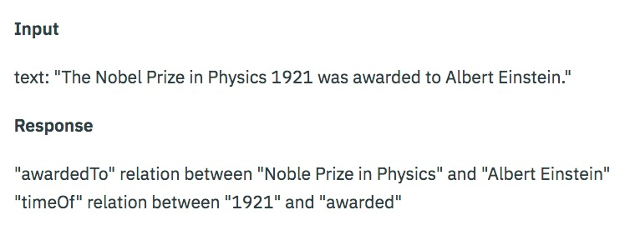
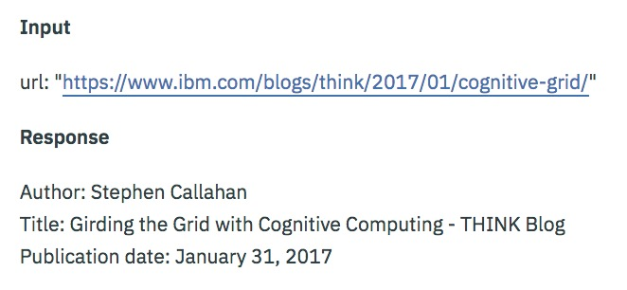
Using the NLU service
Send requests to the API with text, HTML, or a public URL, and specify one or more of the following features to analyse
Keywords
Search your content for relevant keywords
Relations
Recognise when two entities are related, and identify the type of relation
Metadata
For HTML and URL input, get the author of the webpage, the page title, and the publication date

Slide 9
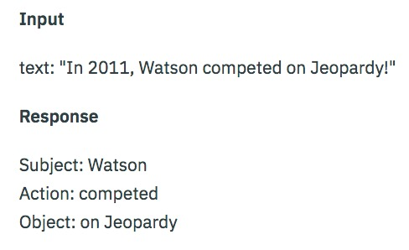
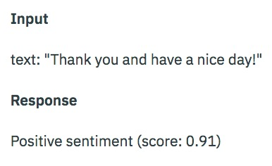
Using the NLU service
Send requests to the API with text, HTML, or a public URL, and specify one or more of the following features to analyse
Semantic Roles
Parse sentences into subject-action-object form, and identify entities and keywords that are subjects or objects of an action
Sentiment
Analyse the sentiment toward specific target phrases or the sentiment of the document as a whole

Slide 10
Cognitive Labs
Lab 5: Watson Natural Language Understanding

